Slide 1
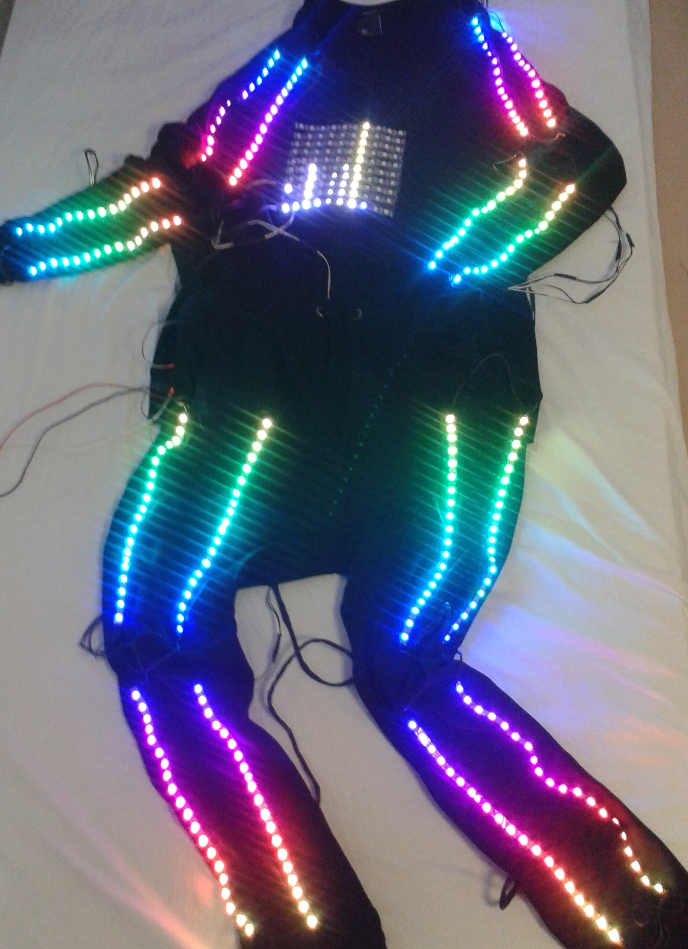
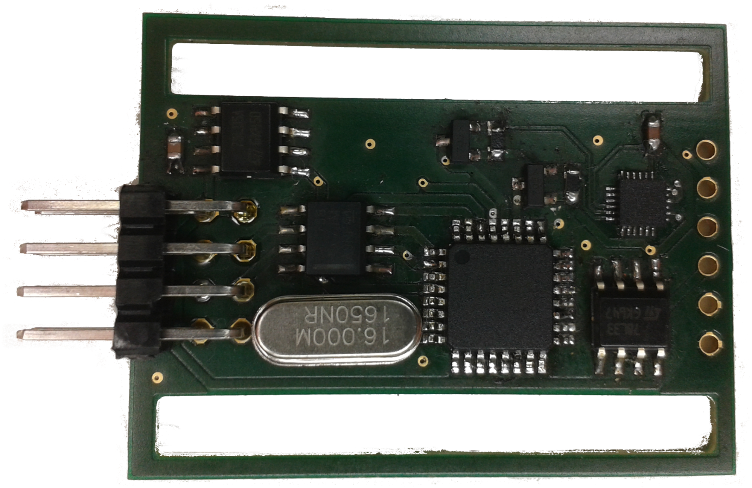
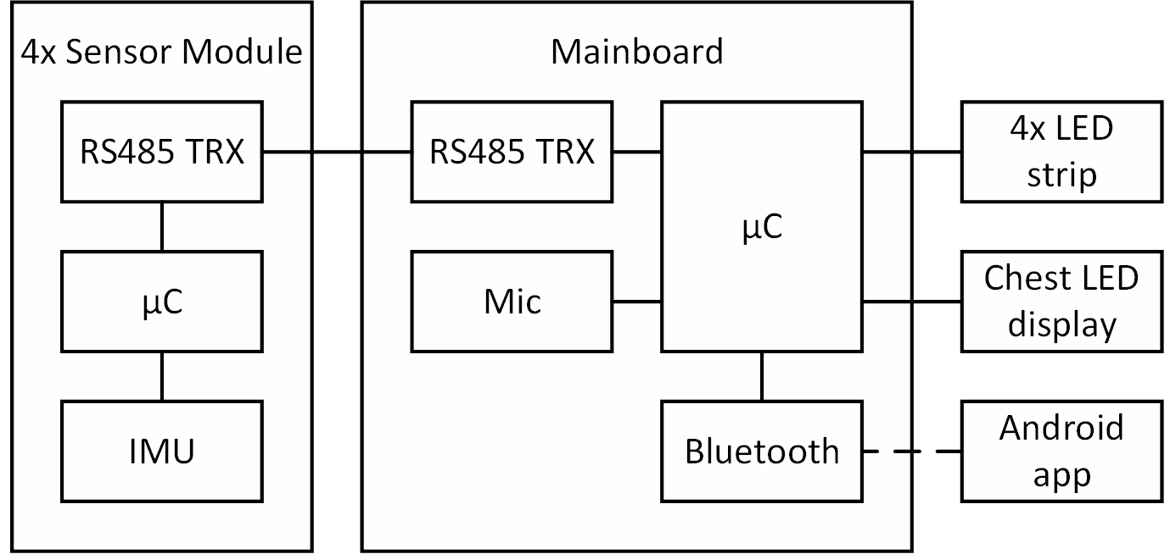
Smart dancing suit
Making music visible
The sound of the environment is measured by a microphone
LEDs react to the environment sound
Intelligent music recognition by applying Fourier transform to the sound measurements
Displaying of the music spectrum on the chest
Reacting to movements
Body movements are detected by IMUs mounted on hands and feet
LEDs react to the movements measured by the IMUs
Creating an audiovisual performance
LEDs change their colors and blinking patterns according to the music and the movements of the wearer
Suit behavior can be configured via android app
Sensor measurements allow generating an LED light show on the fly
Adapting the light show to the dancing moves and music instead of dancing a predefined choreography is what makes the suit “smart”
Hardware achitecture
STM32F411E discovery board with breadboard shield as mainboard
Individually addressable WS2812 RGB LEDs on arms, legs and the chest
10 x 10 LED display on the chest
Sound detection with Adafruit MAX9814 microphone module
Communication with an android app via DFRobot serial Bluetooth module
Bluetooth module uses UART interface to communicate with the microcontroller
Sensor modules on hands and feet for motion detection
Sensor module
Arduino compatible custom sensor board hardware
The IMUs on each sensor board perform 6-axis sensor fusion
Yaw, pitch, roll and 3-axis acceleration data of each sensor board gets sent to the mainboard over an RS485 based master-slave bus
Android app
User can select features for body parts
Colors of the LED
Colors for the color fade function
Display music spectrum
Choose the blinking pattern of the suit
Always on
Stroboscope
Motion detection
Sensor board
Schematic setup of the system
Design of the app menus

